Slide 1

SalesSense
ML-Based Sales Forecasting
Final Year Project
Sadhurshan Rajendran (20222296 / w1989004)
Supervisor: Miss. Akarshani Ramanayake
Informatics Institute of Technology (IIT) in collaboration with University of Westminster

Slide 2









PRESENTATION AGENDA
Context
Technical
Validation
Problem background, Research Gap & Aim
System Design, Tech Stack & AI Model details
Prototype Demo, Evaluation & Testing
Contribution
Future
Summary
Project Novelty & Key Contributions
Limitations & Future Work roadmap
Conclusion & Skills assessment

Slide 3
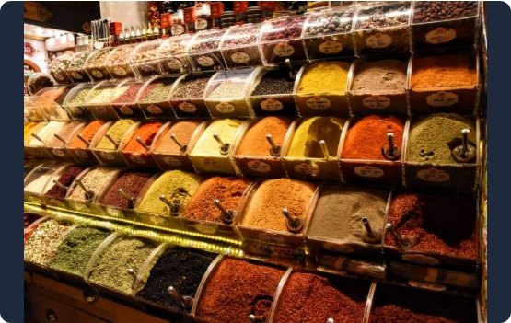

THE PROBLEM
The Core Problem
→
Small-scale specialty spice retailers lack reliable, data-driven forecasting solutions, leading to costly inventory mismanagement (overstocking perishable goods or understocking resulting in missed sales).
Failure of Traditional Methods
→
Relying on manual estimation and basic statistical models fails to capture complex, seasonal, and non-linear sales patterns.
"Traditional models frequently yield low explanatory power for complex retail dynamics." (Ganguly & Mukherjee, 2024)

Slide 4



CRITICAL RESEARCH GAPS
Generalized Data
Operational Gap
Interpretability
Existing studies rely on massive datasets (Walmart), overlooking constraints like perishability in niche spice retail.
Prior research neglects integrating high-accuracy predictions into daily operational planning (Venkiteela, 2025).
High-performing models like XGBoost are often "Black-Boxes", reducing manager trust (Davinder Pal Singh, 2023).

Slide 5

PRIMARY PROJECT AIM
Goal: Design, Develop, and Evaluate a 6-Month Multi-Step Sales Forecasting System
→
Advanced Modeling: Utilize XGBoost to capture non-linear patterns.
→
Transparent AI: Provide interpretable outputs using SHAP values.
→
Decision Support: Enable scenario-based financial and cash-flow analysis & supportive inventory planning

Slide 6
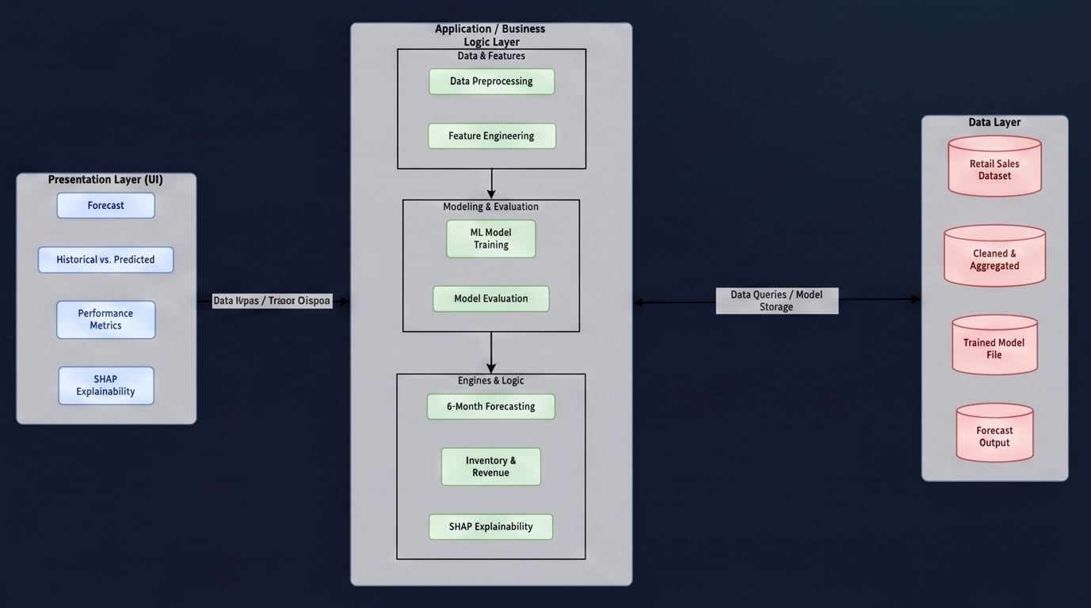
SYSTEM ARCHITECTURE
Multi-Tiered Layering
→
Data Pipeline: Ingestion, preprocessing, and lag-feature engineering.
→
ML Engine: XGBoost forecasting paired with SHAP explainability layer.
→
Business Logic: Translating volume forecasts into cash-flow and inventory metrics.
→
UI Layer: Interactive React dashboards for scenario planning.

Slide 7
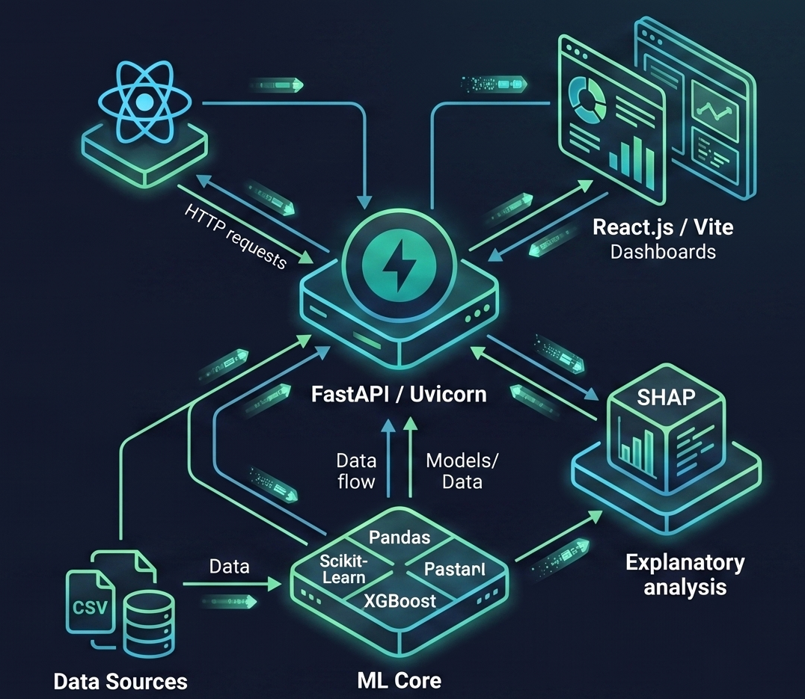
IMPLEMENTATION STACK
Modern Web & AI Stack
→
Frontend: React.js / Vite with Dynamic Dashboards.
→
Backend: FastAPI for efficient routing and high performance.
→
ML Core: Pandas, Scikit-Learn, XGBoost.
→
Explainability: SHAP (Shapley Additive Explanations).

Slide 8

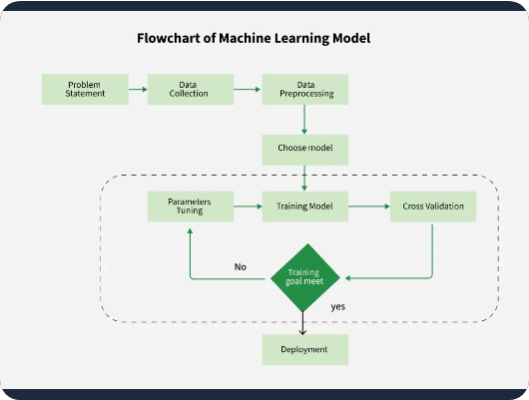


MODEL PIPELINE & DATA
AI/ML Modal Pipeline & Details
Data & Feature Engineering
→
Source: Historical transactional data from a single-store specialty shop.
Dataset & ETL
Model & Training
Source: Proprietary unstructured records from a spice shop.
Size: 43 monthly records (April 2022 – Jan 2026). Split 40:3.
Custom ETL: Parser with regex and dynamic header detection to clean inconsistent Excel bookkeeping files.
Algorithm: XGBoost selected for superior performance on small tabular data over LSTMs.
Tuning: Strict regularization (LR=0.05, Depth=3) to prevent overfitting to SME noise.
→
Engineering: Time-based lags to capture seasonality (e.g., cultural festivals).
→
Feature Engineering
Experiments
Model Selection: Benchmarked XGBoost against LSTM and Random Forest.
Short-term: Generated Lag1, Lag2, Lag3.
Trends: RollingMean3, RollingStd3.
Seasonality: MonthNum, MonthOfYear features.
Comparative: RF, Linear Regression, and LSTM tested before finalizing XGBoost.
Real-time Architecture: FastAPI asynchronous state management for on-the-fly training upon data upload.
→
Optimization: Cross-validation for 6-month multi-step horizons.

Slide 9
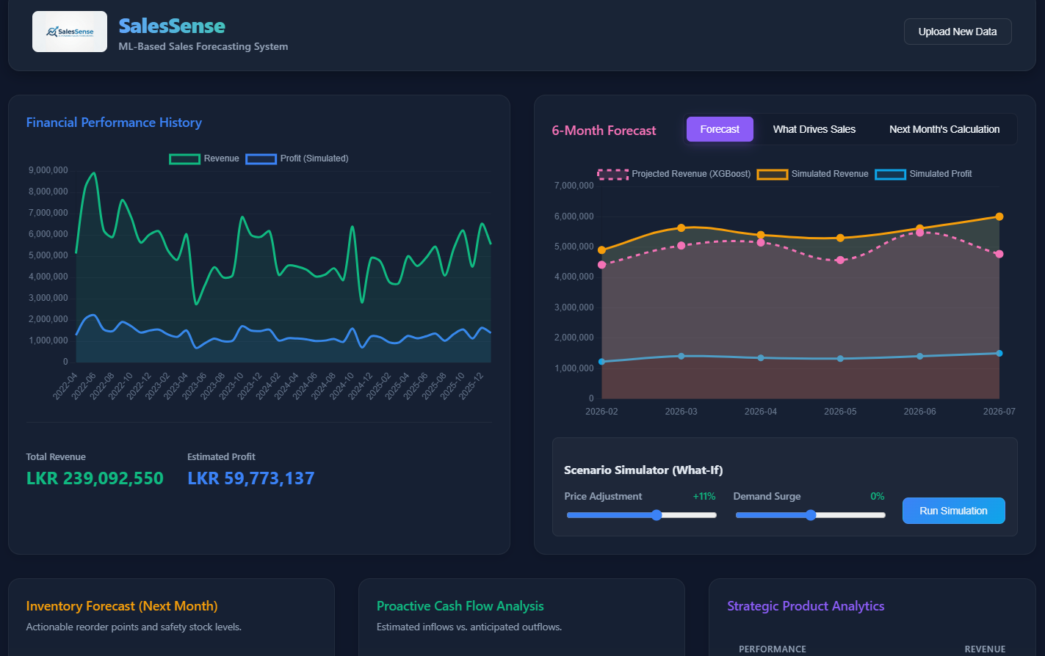
SYSTEM DEMONSTRATION
Core Dashboard Features
→
Forecasting: Visualizing 6-Month sales trajectories.
→
Explainability: SHAP Dashboard showing feature impact on individual predictions.
→
Financials: Scenario-based adjustment of business parameters.
→
Actionable: Automatic translation to inventory requirements.

Slide 10





Outcome: XGBoost effectively balanced linear trends and high seasonality over the horizon. Proved that engineered lag features enable high performance without "Big Data" infrastructure.
EVALUATION METRICS
Testing & Evaluation
A. Evaluation Conducted
B. Outcomes & Contributions
Quantitative: 43 months data training vs 3 months test. Metrics: RMSE, MAE, MAPE, R² Score.
Qualitative: Functional Testing (100% Pass) & User Focus Group validation.
Superiority: XGBoost outperformed RF & LR. LSTM failed due to small dataset size.
Contribution: Bridged gap between statistics and business value through automated inventory & cash flow translation.
12.3%
714k
Challenge: Sparse 43-month dataset and limited empirical expenditure data.
MAPE ERROR
RMSE METRIC

Slide 11






PROJECT NOVELTY
Actionable Value
Transparent AI
Dynamic Framework
Systematically translates ML forecasts into immediate inventory levels and cash flow scenarios.
Integrating SHAP in a small retail context to break the "Black-Box" and foster SME user trust.
Interactive "What-If" scenarios allowing owners to adjust costs against predicted trajectories.

Slide 12


GROWTH & CONSTRAINTS
Current Limitations
Future Work
→
Small historical dataset from a single entity.
→
Macroeconomic & Social media trend integration.
→
No real-time external data stream ingestion.
→
Multi-tenant SaaS platform expansion.
→
Automated POS data ingestion.

Slide 13


SKILL ASSESSMENT
Conclusion & Summary
Professional Competencies
Final Strategic Summary
Advanced New Skills
→
XGBoost Mastery: Hyperparameter tuning & multi-step forecasting.
Applied Existing Skills
New Skills Developed:
Bridge the Gap: Successfully connected complex ML forecasting with practical SME usability.
•
Advanced ML (XGBoost & Tuning)
→
Full-stack Software Engineering.
→
AI Explainability: SHAP integration.
→
Interpretable Tool: Developed a highly accurate tool tailored specifically for the spice retail domain.
•
Model Interpretability (SHAP)
System Architecture & API Development.
→
•
Real-time Financial UI Development
Financial UI: Translating ML logic into finance dashboards.
→
Database Management.
Utilized Foundation:
Structured Strategy: Established a methodology for turning theoretical data into proactive business strategies.
•
Full-stack Software Engineering
•
Architecture & API Development

Slide 14
THANK YOU
Questions & Answers
Sadhurshan Rajendran | SalesSense Project

